Slide 2
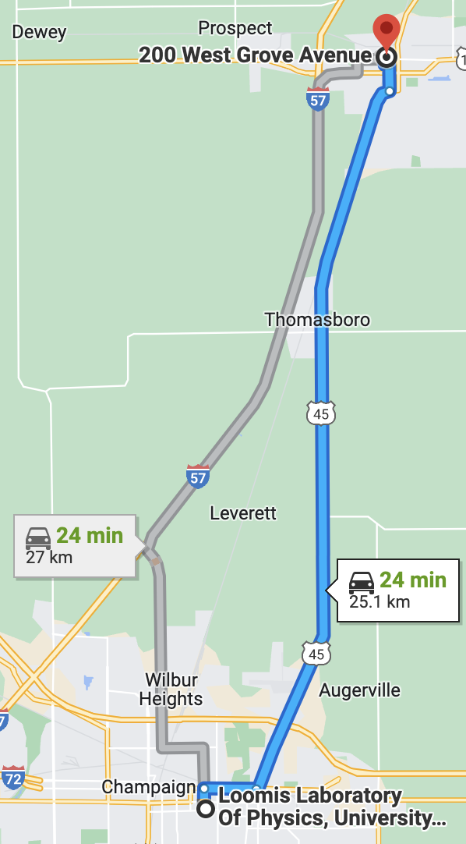
Rantoul Fiber Link
Fiber Loop from UIUC→Rantoul→UIUC
52.6km of fiber
~18.5dB of loss at 1550nm

Slide 3
Polarization Stability
Send different wavelengths utilizing tunable laser
1540-1560nm
Measure the polarization after sending light of different wavelengths through the loop over multiple hours

Slide 4
Polarization Stability
See Frequency based polarization drift for the H/V basis

